Slide 1

Banking Data Analytics Report
3000 records • 25 columns • End-to-end analytics

Slide 2

Dataset Overview
Total Records
3000
Total Columns
25

Slide 3

Methodology
Load & Inspect
CSV → pandas, .info(), .describe(), null checks
Clean & Transform
Handle missing values • fix dtypes • rename columns
EDA & Visuals
Univariate, histograms, heatmap, correlations
Delivery
Power BI dashboard • DB load (Postgres)

Slide 4

Sample EDA — Initial Queries
Key checks
df.head(5) • df.shape → (3000,25) • df.info()
Columns standardized: lower_case, underscores
Created income_band via pd.cut

Slide 5
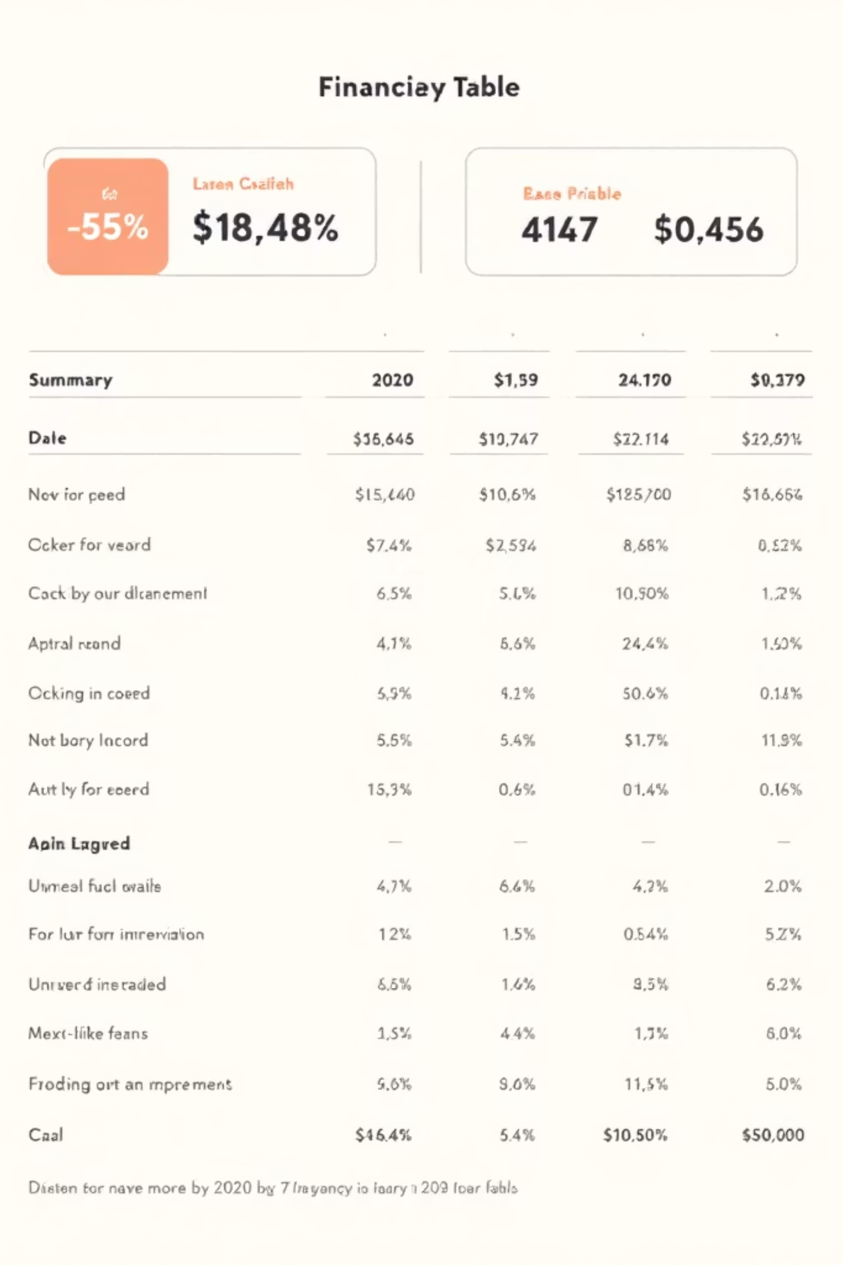
Descriptive Stats — Highlights
51
$171K
$671K
Median Age
Mean Income
Avg Deposits
50–51
171,305.03
671,560.2

Slide 6
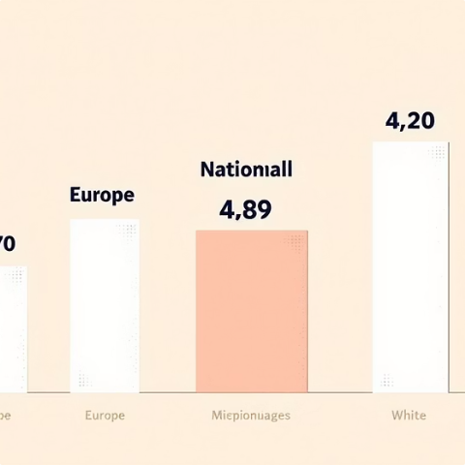
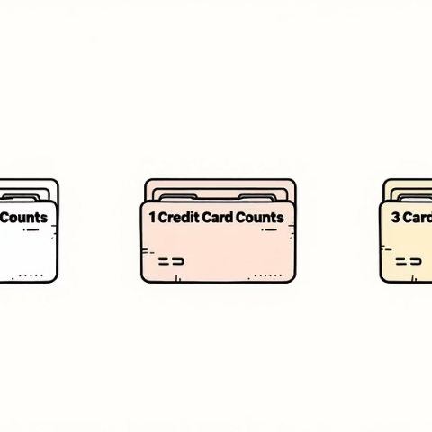

Categorical Distributions
Nationality
Credit Cards
Fee Structure
European 1309 • Asian 754 • American 507
1:1922 • 2:765 • 3:313
High 1476 • Mid 962 • Low 562

Slide 7

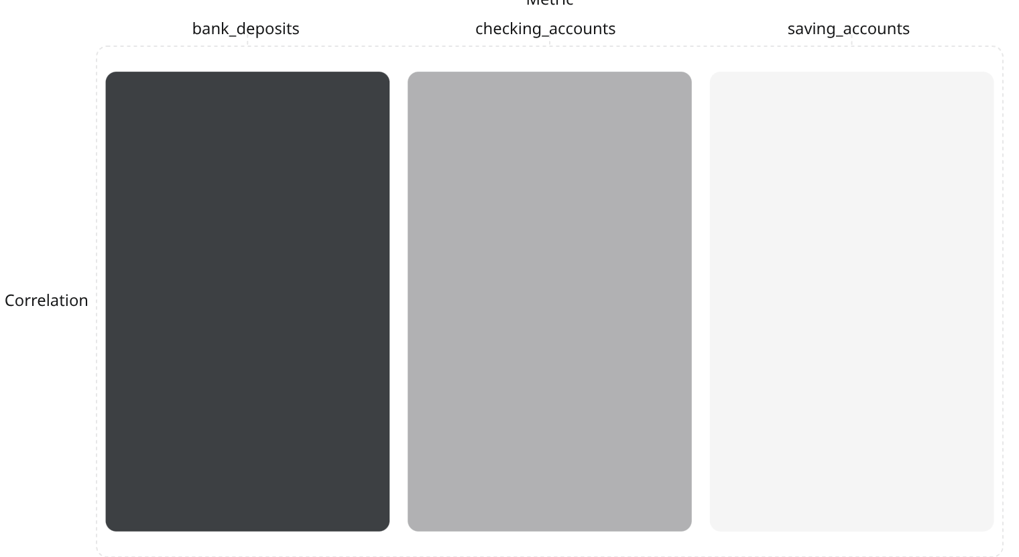
Numeric Analysis & Correlations
Key finding
Strong positive correlation: bank_deposits ↔ checking_accounts & saving_accounts
Use correlations to target cross-sell and segment high-value customers.

Slide 8
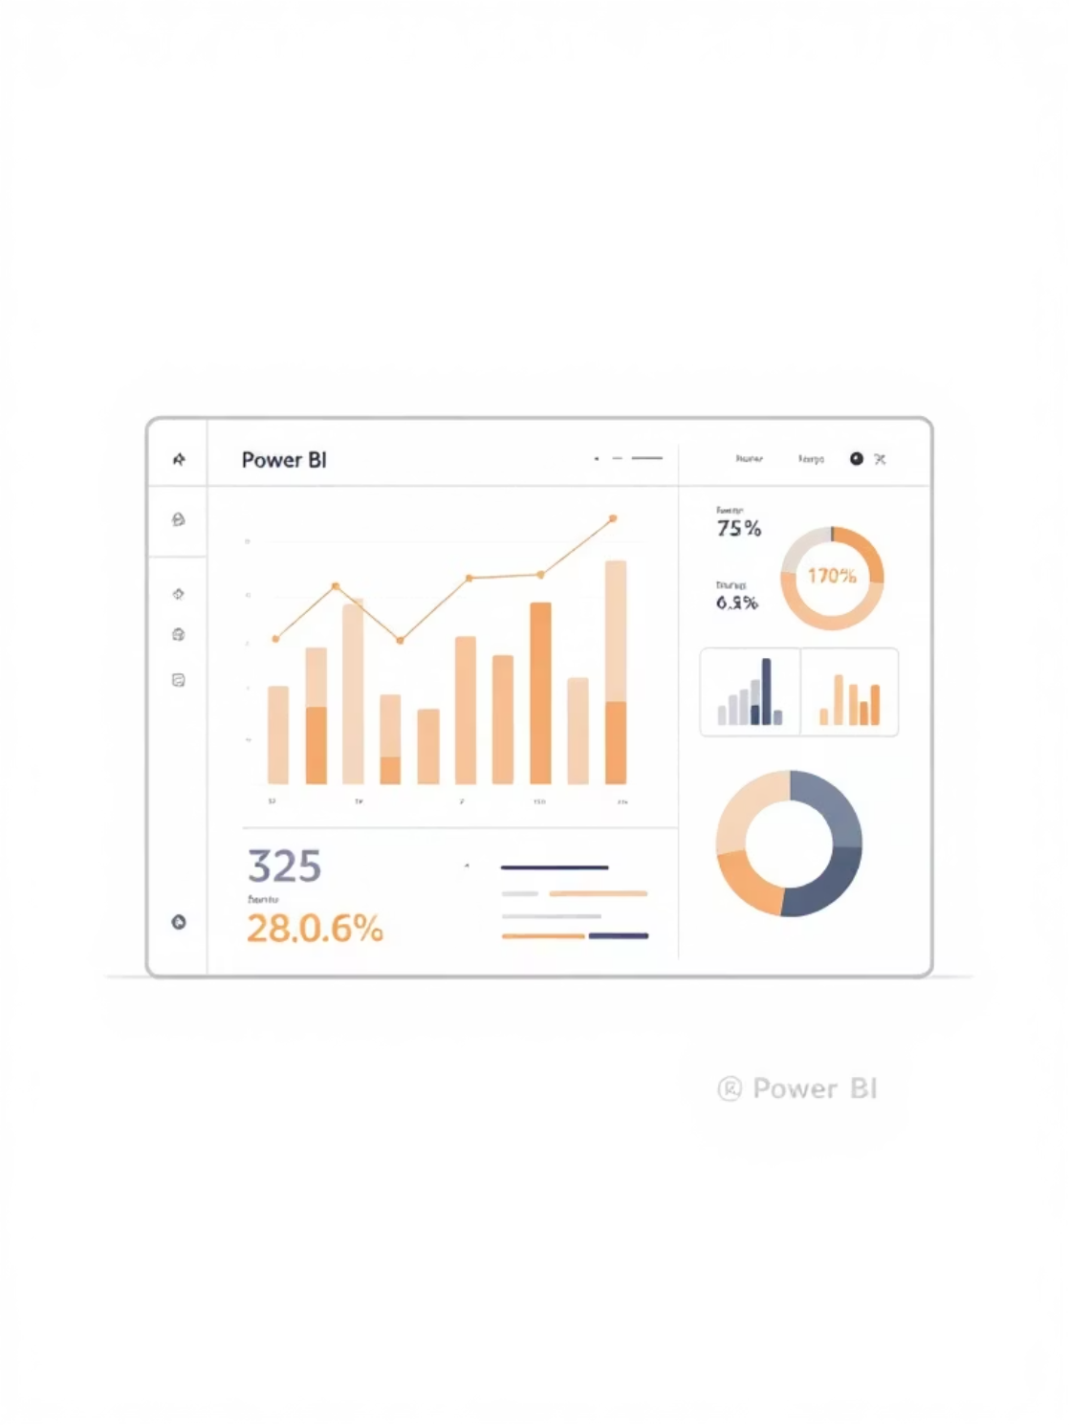
Power BI Dashboard
KPI Cards
Filters & Drilldown
Insights
Total customers, account distribution, loan metrics
High-value segments • Loan/deposit trends • Revenue by category
By segment, product type, financial category

Slide 9

Data Delivery
DB Load
Engine: Postgres • Table: customer • df.to_sql → replace
Confirmation
Data successfully loaded into table 'customer' in database 'bank_data'.

Slide 10

Conclusion & Next Steps
Complete Workflow
Raw data → EDA → Dashboard → DB
Actionable BI
Segment high-value customers • Inform product strategy
Recommended Next Steps
Modeling (scoring) • A/B on offers • automated ETL

